Slide 1
LinkedIn: Fraudulent Job Detection
Presented by:
Anusha Ravichandran
Pooja Sounder Rajan
Notes:
Good afternoon, everyone. Today, we are excited to present our project on LinkedIn Fraudulent Job Detection. My name is Anusha Ravichandran, and I am joined by Pooja for this. We’ll discuss a significant challenge on professional platforms—fraudulent job postings—and our approach to detecting them.

Slide 2
Overview:
The Problem:
Surge in fraudulent job postings on LinkedIn, with a 118% increase in scams in 2023.
Scammers exploit the rise of AI technologies and remote work to deceive job seekers.
Victims lose around $2,000 on average and risk exposure of sensitive data (e.g., financial info, Social Security numbers).
Why It Matters:
Fake job scams harm job seekers, erode trust in professional platforms, and compromise data security.
A reliable detection system can protect users and uphold LinkedIn’s credibility.
Notes:
In recent years, LinkedIn has seen a sharp 118% rise in fraudulent job postings, largely driven by AI-enabled scams and the increase in remote work. These scams cost victims an average of $2,000, exposing sensitive information like Social Security numbers.
Why does this matter? These scams undermine trust in platforms like LinkedIn and jeopardize user data. Developing a robust detection system is essential for user safety and LinkedIn's credibility."

Slide 3
Related Works
Automated tool using machine learning classification techniques to detect fraudulent job postings.
Analyzed 2,670 social media posts and comments related to employment scams.
Explores neural network architectures and preprocessing strategies for identifying anomalies in recruitment data
Machine Learning
Based Approaches
Characteristics of Job Scams
Online Recruitment Fraud (ORF) Detection Using DL Approaches
Why OURS…….?
Notes:
Broader Applicability:
While grounded in LinkedIn data, our framework can easily be adapted for other professional platforms.

Slide 4
Hypothesis
1: Fraudulent job postings will have description lengths that closely mirror legitimate job postings
2: Major metropolitan areas, particularly New York, Chicago, and Houston, will show a significantly higher concentration of fraudulent job postings compared to smaller cities, as scammers target locations with larger job markets and higher population density to maximize their potential victim pool.
Notes:
Today we'll examine how scammers attempt to make their fraudulent job postings appear legitimate by matching the length of legitimatejob descriptions. This makes it harder for job seekers to spot fake listings at first glance Our second hypothesis focuses on the geographical targeting of job scams. We predict that fraudulent postings will be concentrated in areas specifically New York, Chicago, and Houston. This concentration occurs because:
These cities offer larger job markets
They have higher population density
Scammers can reach more potential victims

Slide 5
Data collection
Kaggle Datasets
Google Survey Form
Four main questions were asked to the respondents:
D1: Employment Scam Aegean Dataset (EMSCAD)
D2: LinkedIn Job Postings Dataset
Have you come across a LinkedIn job posting that seemed suspicious or fake?
What position level did the suspicious job claim to offer?
What were some of the red flags in the suspicious job listing?
What industry was the suspicious job posting in?
Notes:
The data for this research comes from two primary sources:
We have data from Kaggle Datasets
D1: The Employment Scam Aegean Dataset (EMSCAD) provides baseline data about employment scams
D2: The LinkedIn Job Postings Dataset offers examples of legitimate job listings for comparison
We designed a survey with four strategic questions to gather user experiences:
The first question assesses general exposure to suspicious LinkedIn job postings
The second question examines the seniority level of suspicious positions
The third question identifies common red flags users have encountered
The fourth question tracks which industries are most affected by scam postings
This dual approach combining existing datasets with primary survey data allows for a comprehensive analysis of LinkedIn job scam patterns and characteristics.

Slide 6
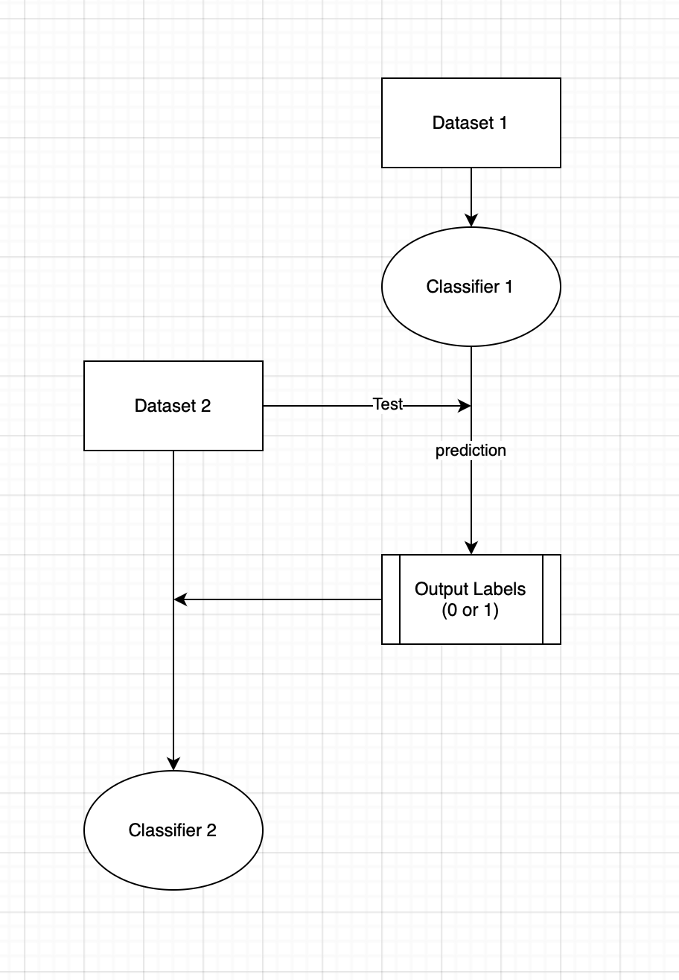
Methodology
01
The Employment Scam Aegean Dataset is used as the primary dataset, with two key features selected for training the model.
02
A MultinomialNB classifier is trained on the transformed dataset to classify job postings as legitimate or fraudulent.
03
The trained MultinomialNB model is applied to a new dataset of LinkedIn job postings to detect potentially fraudulent listings.
04
A Logistic Regression classifier is trained on the LinkedIn dataset with added fraud predictions, improving accuracy and addressing class imbalance using data balancing techniques.
05
The model's performance is evaluated using: A Confusion Matrix to assess accuracy. A Classification Report to analyze precision, recall, and F1-score.
Notes:
The Employment Scam Aegean Dataset serves as our foundation, where we carefully selected two critical features to train our initial model.
We implement a MultinomialNB (Naive Bayes) classifier as our first model, specifically designed to differentiate between legitimate and fraudulent job postings in the transformed dataset.
The trained MultinomialNB model is then deployed on LinkedIn job postings dataset to identify potential fraud listings.
We then implemented a Logistic Regression classifier on the LinkedIn dataset. This second classifier incorporates:
Previous fraud predictions
Data balancing techniques to handle uneven class distribution
Enhanced accuracy measures
We assess the model's effectiveness through confusion matrix and classification report
The flowchart on the left illustrates how Dataset 1 feeds into Classifier 1, while Dataset 2 undergoes testing to generate predictions. These predictions are then processed as binary output (0 or 1) before being fed into Classifier 2 for final classification.

Slide 7
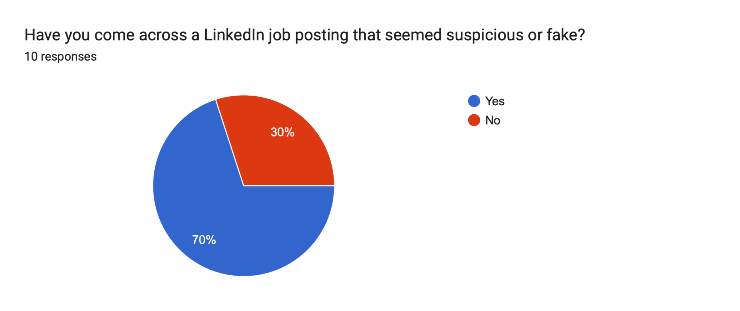
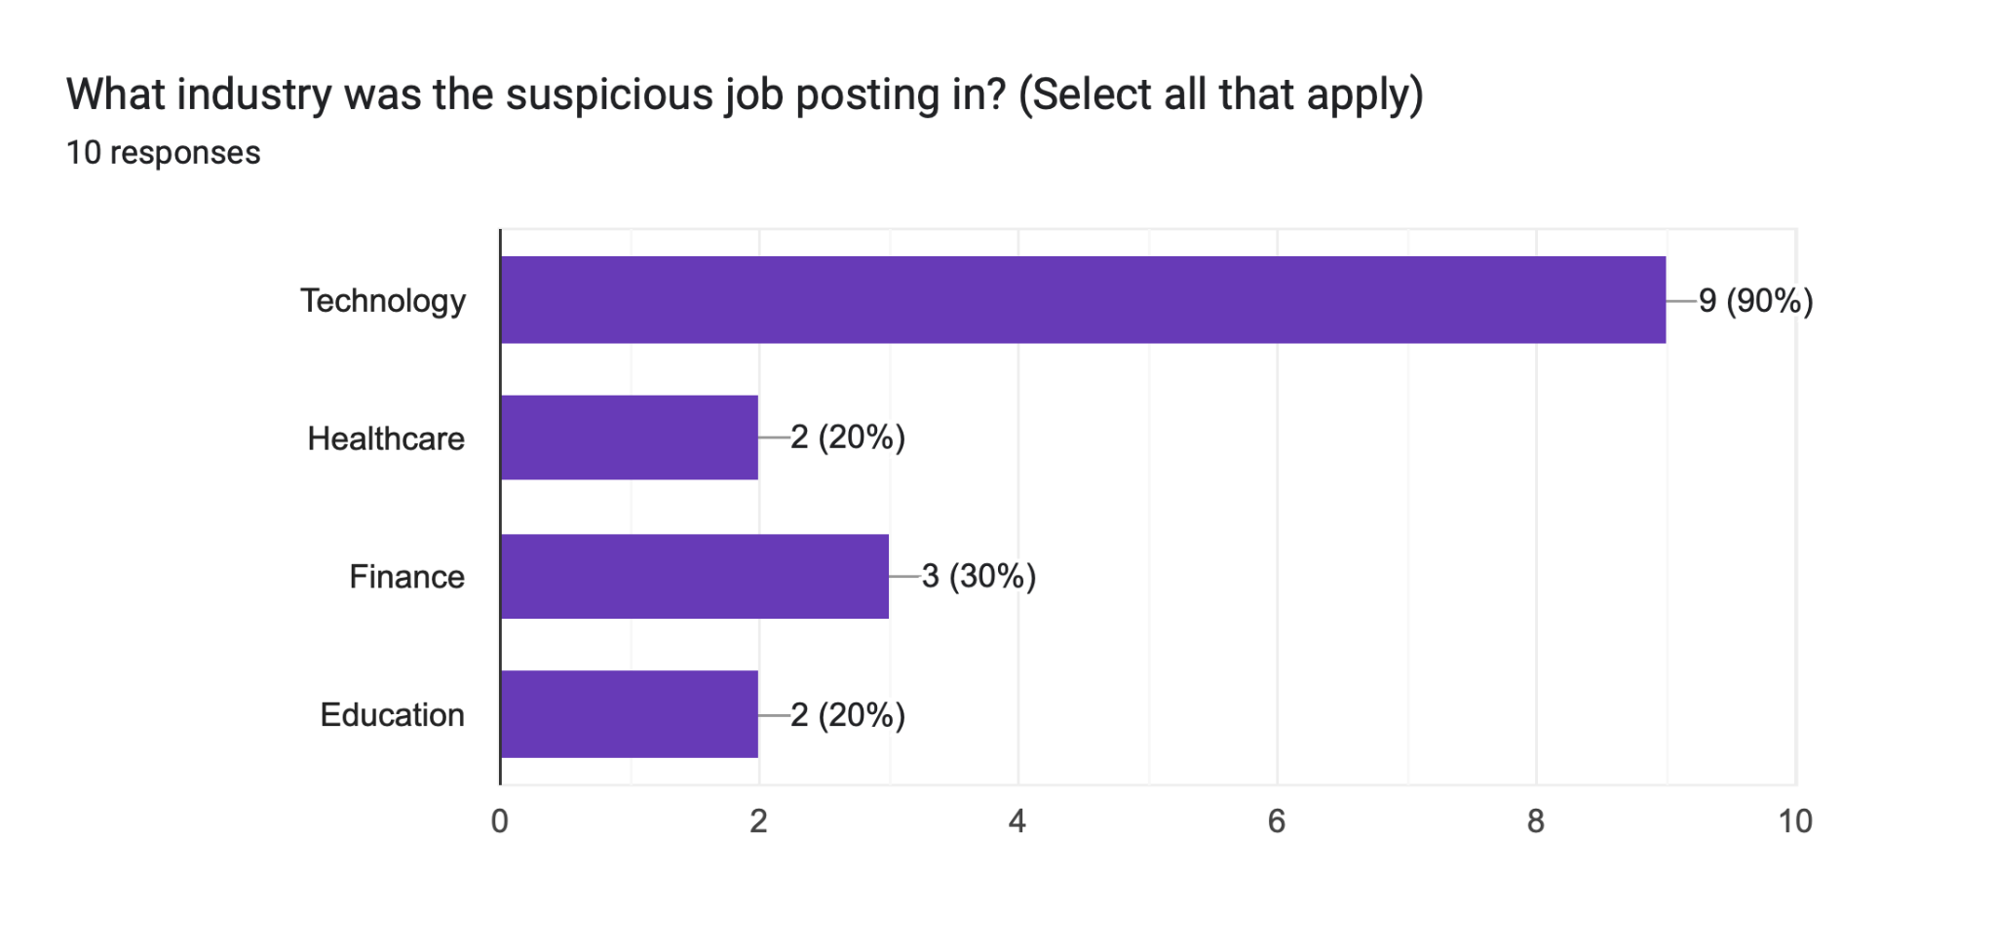
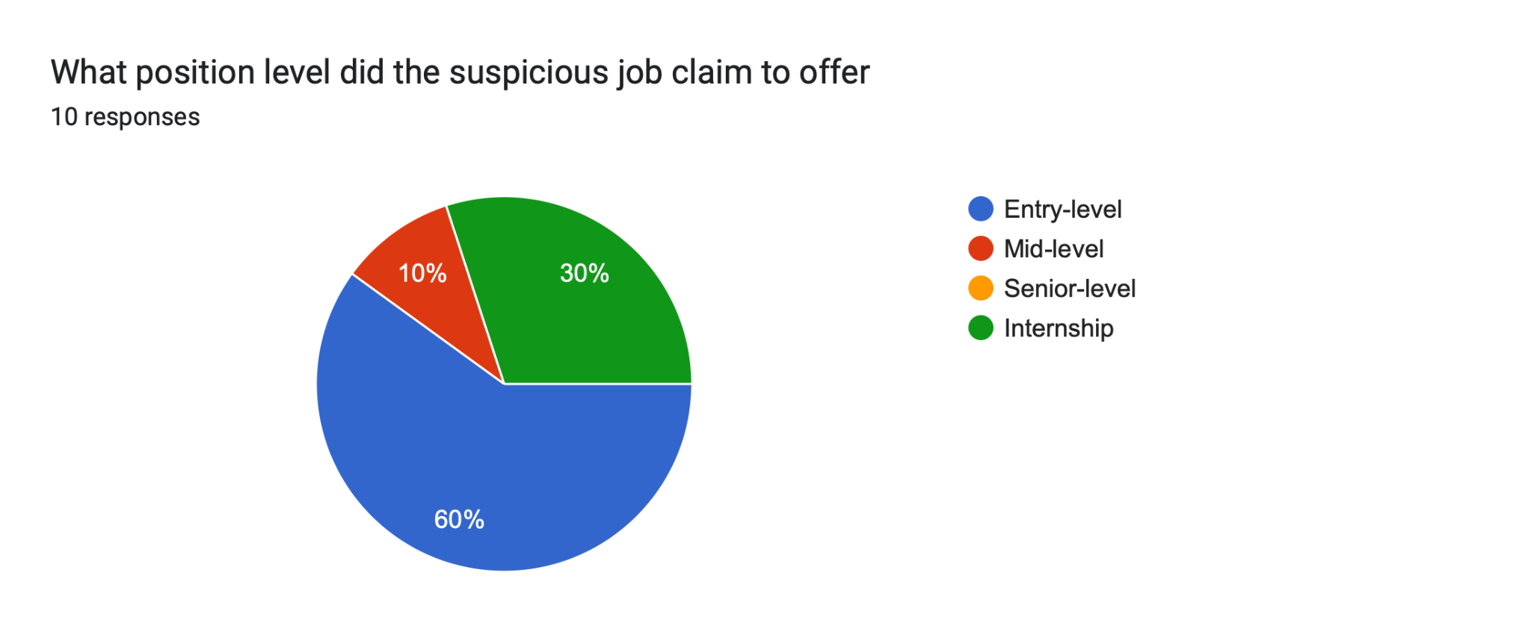
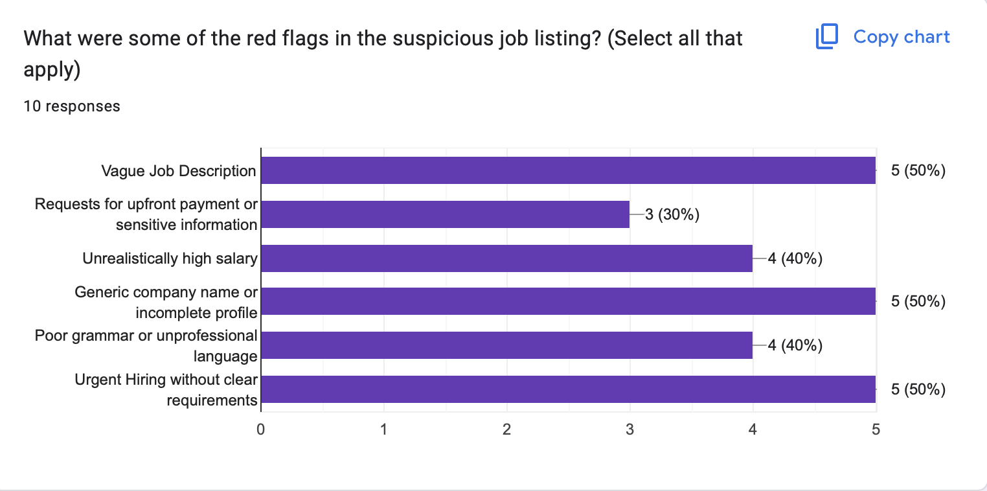
Findings
Notes:
The survey reveals that around 70% of the respondents faced suspicious LinkedIn job postings, primarily in the technology sector (90%), with most being entry-level positions (60%), and the top red flags being vague job descriptions, upfront payment requests, and unrealistic salary offers of 50% each.

Slide 8
Results
Employment Scam Aegean Dataset (EMSCAD)
Accuracy
Linkedln Job Postings Dataset
Accuracy
Precision
Precision
79%
95%
Recall
Recall
82%
81%
96%
96%
F1-Score
F1-Score
81%
96%
Fraudulent class - 1
Fraudulent class - 1
Notes:
The models achieved strong performance metrics. For EMSCAD, we observed an accuracy of 81%, with precision and recall scores of 82% and 81%. The LinkedIn dataset yielded even higher results, with a precision and recall of 96%.

Slide 9
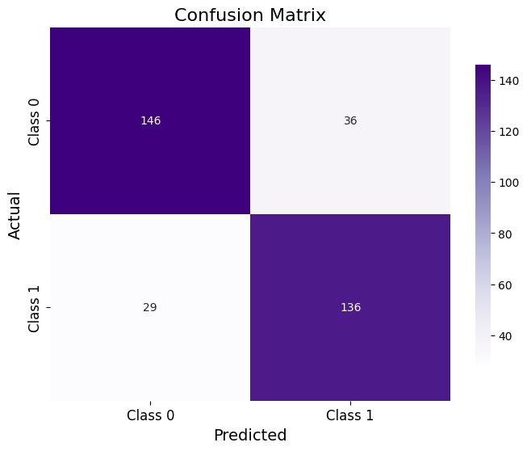
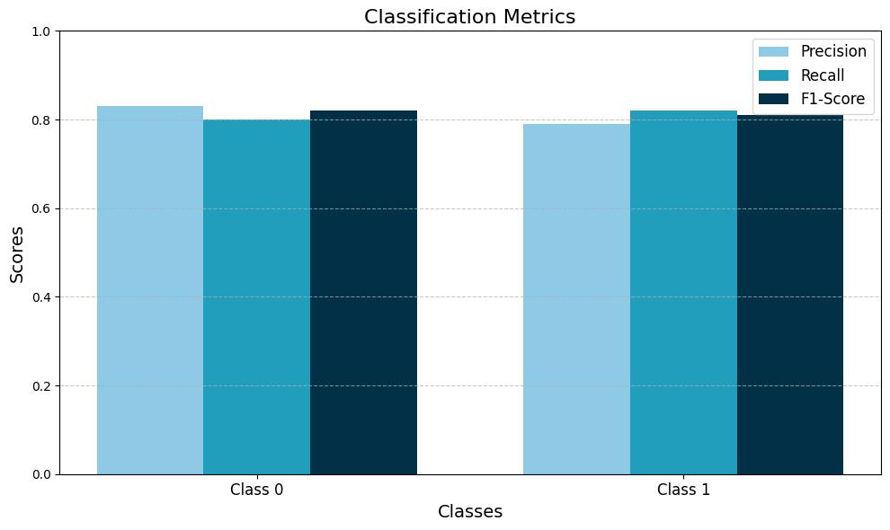
Classification Report

Slide 10
Analysis

Slide 11
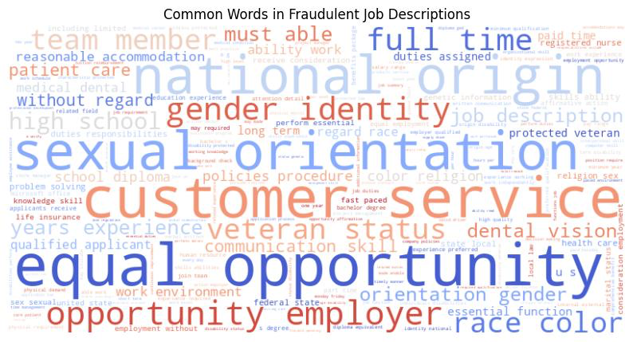
1. Common words in fraudulent job descriptions
The word cloud reveals that fraudulent job postings frequently use terms related to equal opportunity employment and workplace policies, with words like "sexual orientation," "gender identity," "equal opportunity," and "national origin" appearing in large text.
The presence of terms like "customer service," "full time," and “veteran status" indicates that scammers strategically use professional terminologies to create an appearance of legitimacy.
This suggests fraudsters attempt to appear legitimate by heavily incorporating anti-discrimination language.

Slide 12
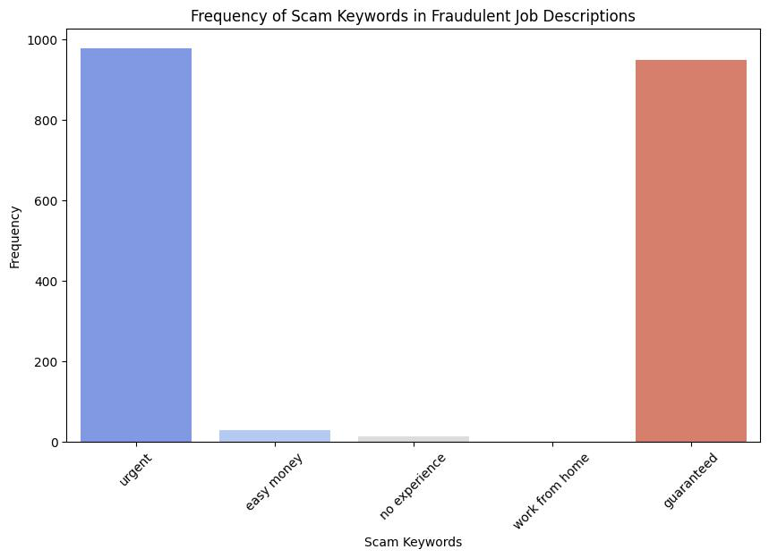
2. Frequency of Scam Keywords
"Urgent" and "guaranteed" are the most frequently occurring scam indicators in fraudulent job postings, appearing approximately 1000 times each.
"Easy money" and "no experience" appear less frequently, suggesting scammers may avoid these more obvious red flags.

Slide 13
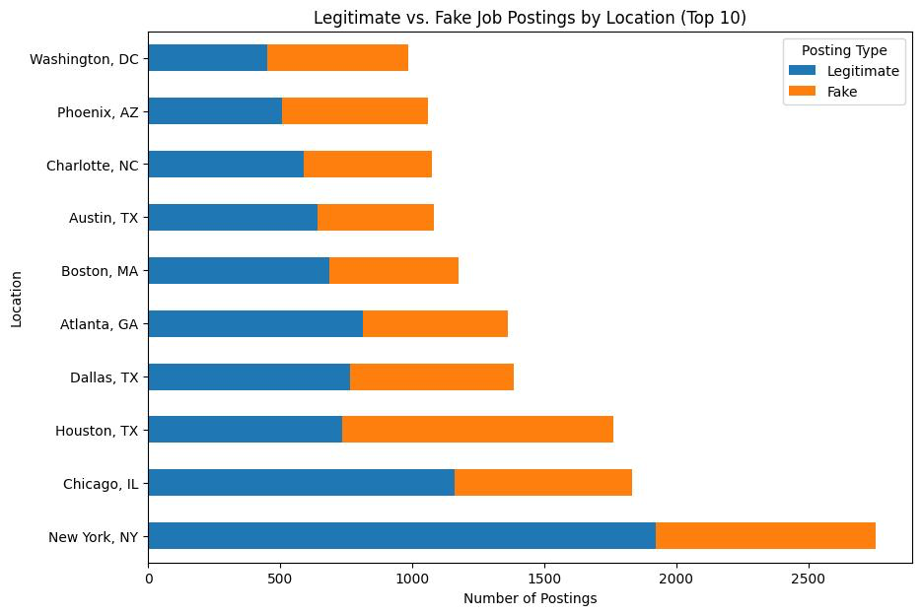
3. Location-wise Postings
New York, NY emerges as the most targeted location, with significantly higher numbers of both legitimate and fraudulent postings compared to other cities.
Major metropolitan areas dominate the top 10 locations.
Smaller cities like Phoenix and Charlotte have proportionally higher rates of fraudulent postings relative to their total posting volume.

Slide 14
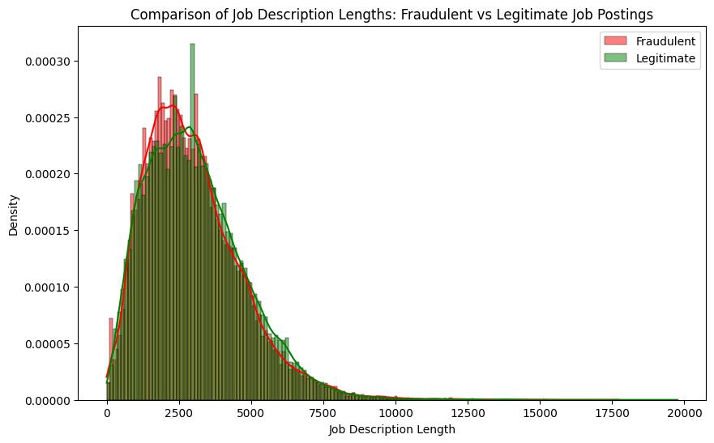
4. Description Length
Fraudsters are crafting job descriptions that closely mimic the length patterns of legitimate postings.
This makes it necessary to look beyond just the description length to identify fraudulent listings.

Slide 15
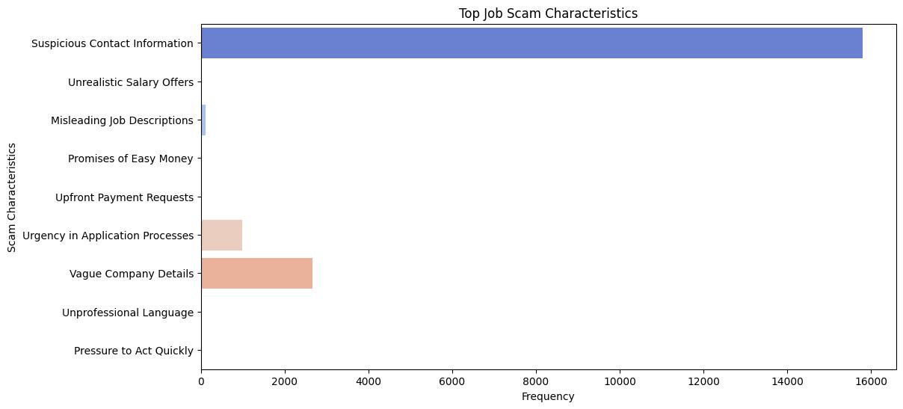
5. Scam Characteristics
Suspicious contact information stands out as the most prevalent characteristic. This suggests that irregular or questionable contact details are the most reliable warning.
Urgency-related characteristics and Financial red flags collectively show significant and less presence.

Slide 16
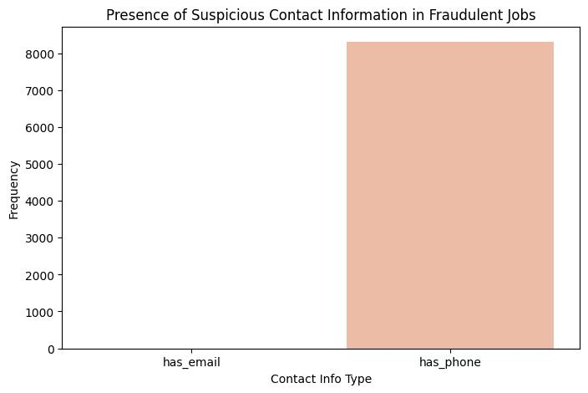
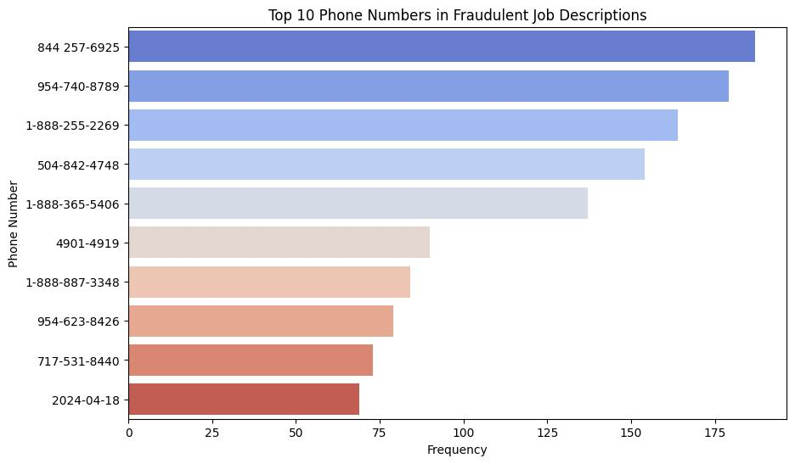
6. Contact Information in Fraudulent Jobs
Suspicious phone numbers are the most common form of contact information and email is not visible on the graph, suggesting that suspicious email addresses are either non-existent or extremely rare in fraudulent job postings compared to phone numbers.
Fraudsters either use consistent contact information or a mix of toll-free numbers (starting with 1-888) and regular phone numbers.

Slide 17
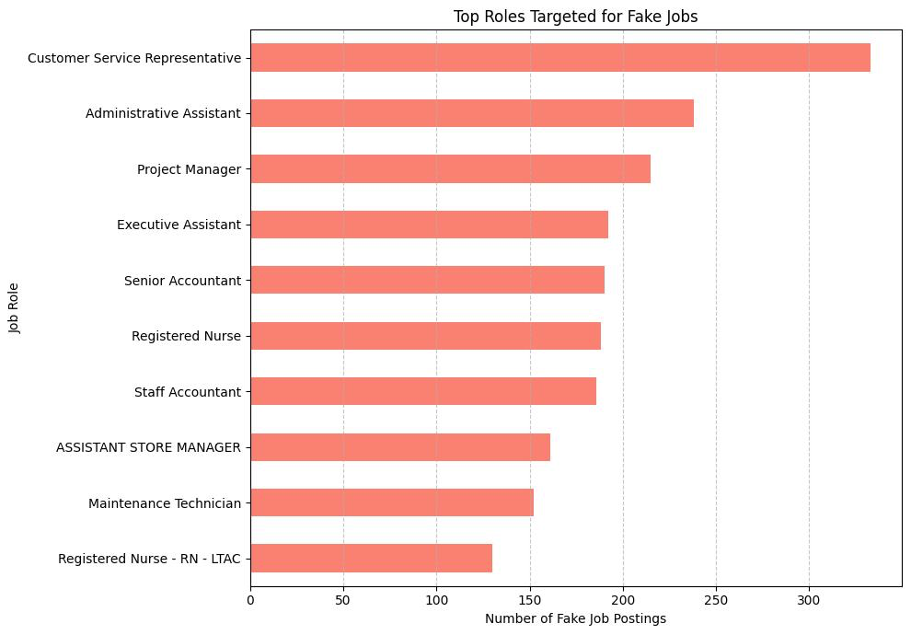
7. Targeted Roles
Customer Service Representative emerges as the most frequently targeted role for fake job postings, with approximately 300 fraudulent listings, significantly higher than other positions.
The data reveals that scammers employ a dual strategy: heavily targeting entry-level positions for their accessibility while also creating sophisticated scams for higher-paying professional and healthcare roles to maximize potential gains.

Slide 18

Future Works
1. Development of Predictive Tools
Web Application Creation: Develop a user-friendly web application that allows job seekers to input job postings for scam predictions. This tool could leverage machine learning algorithms to assess the legitimacy of postings based on historical data.
2. Continuous Learning Models
Adaptive Algorithms: Implement machine learning models that continuously learn from new data, allowing them to adapt to evolving scam tactics and improve detection accuracy over time.
3. Enhanced Data Analysis
Economic Impact Studies: Investigate how economic cycles and job market trends influence the prevalence of fraudulent postings. This research could help identify peak times for scams and improve response strategies.

Slide 19
Conclusion
Job seekers need to be vigilant, especially when applying for entry-level positions or roles in customer service.
LinkedIn and other job platforms should implement robust detection systems to protect users and maintain platform credibility.
Awareness of red flags, such as suspicious contact information and urgency in job postings, is crucial for users.
Thank You
Notes:
Job seekers must stay alert to red flags, while platforms like LinkedIn should implement robust detection systems to ensure user safety and trust.

